Slide 1
Should we keep pi?
Camylle Buck

Slide 2
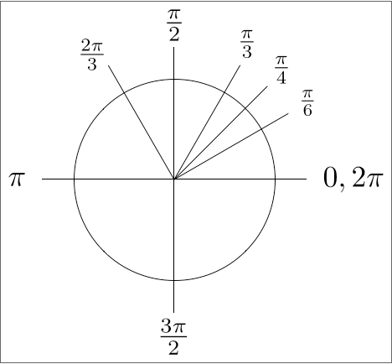
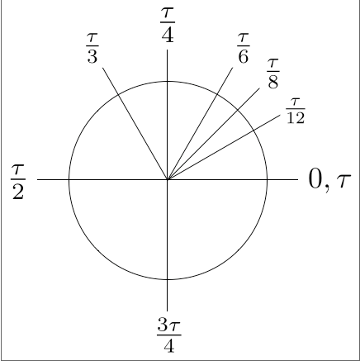
Tau as the new circle constant?
Pi is C/d where tau would be C/r
τ=2π

Slide 3
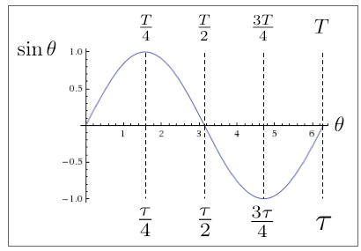

Slide 4
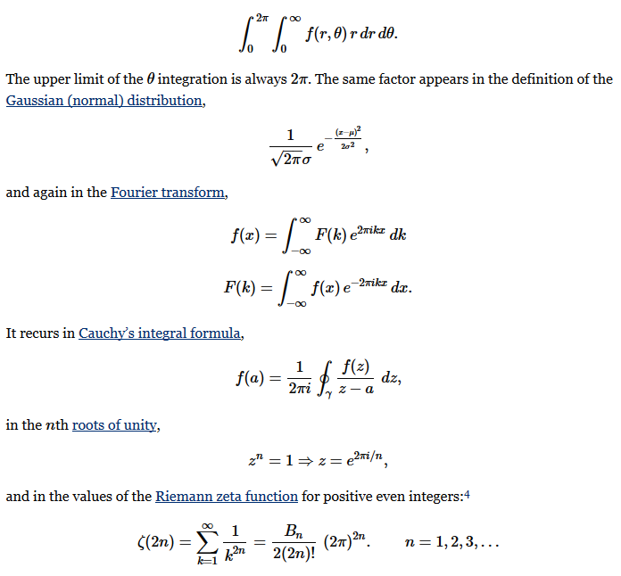

Slide 5
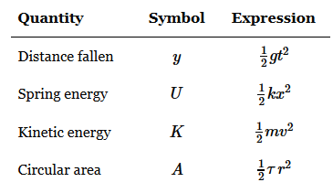
πr^2
Physics: a=1/2mv^2 through integration
Area of circle = 1/2τr^2 through integration

Slide 6
Information
http://www.tauday.com/tau-manifesto

